Slide 1

Entropic diffusion in confined soft-matter and biological systems
Miguel Rubi
Transport phenomena in complex environments,
Ettore Majorana Centre, 2019

Slide 2
Outline
Entropic transport models
JMR, EPL-Perspectives (2019)
Diffusion through flexible channels

Slide 3
Motivation
To know how particles move in small cavities, micro-channels and in general in crowded media currently constitutes a challenge for the understanding of basic mechanisms governing the behaviour of small-scale soft-matter and biological systems.
The presence of obstacles, constrictions and irregularities in the shape of these structures significantly alter their trajectories thus modifying their transport properties.
An analysis of these properties based on the use of diffusion and stochastic equations faces the problem of solving these equations for very complex boundaries which may constitute a formidable task.

Slide 4
Modelling confined diffusion
- Entropic transport models apply when the structure of the medium is such that particles may move more easily along a preferred direction of motion.
- Ex. particles diffusing in narrow channels or in crowded media being acted upon by an external force. Changes in the positions and momenta of the particles occur mainly along longitudinal direction whereas local equilibration is rapidly reached in transverse directions.
- One can perform a coarse-graining description in which transport is practically quasi-1D and the effect of the tortuosity of the boundaries is considered through entropic barriers.
Free energy of mean force:
Fick-Jacobs
D. Reguera, JM Rubi, Phys. Rev. E, 64, 061106 (2001)

Slide 5
Effective diffusion coefficient:
(2d)
(1d)

Slide 6
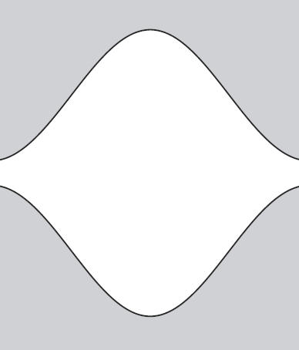

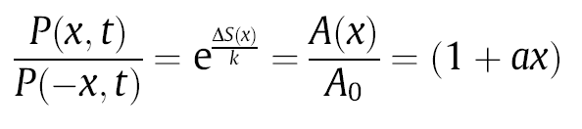
Entropic forces
-Confinement induces entropic forces
-Rectification mechanism

Slide 7
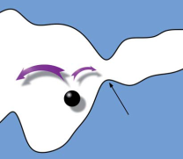
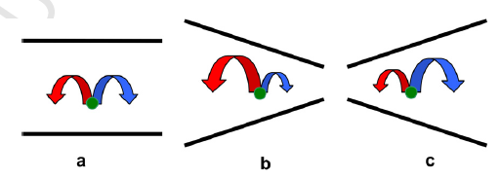



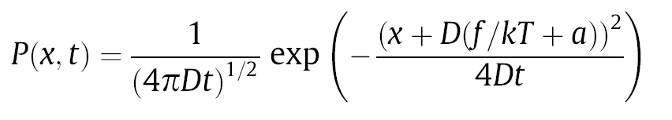
Entropic rectification
Entropic barrier
Coarse-graining:
Entropic rectification
J.M. Rubi, D. Reguera, Chem. Phys. 375 (2010) 518

Slide 8
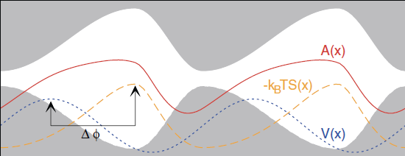
Cooperative rectification
Impurities attached:
The mismatch between ratchet potential and channel corrugation gives rise to the appearance of a net current even when both potentials are symmetric.

Slide 9
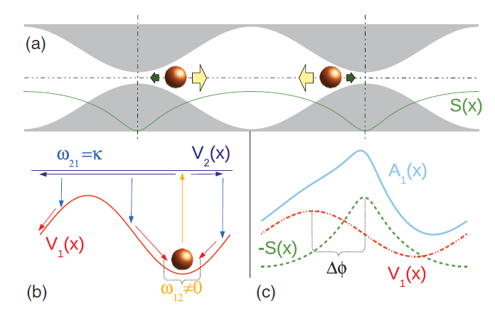
Cooperative Rectification in a two-state molecular motor model
P. Malgaretti, I. Pagonabarraga, J.M. Rubi, PRE (2012)

Slide 10
Entropic barriers
Porous medium
Porosity:

Slide 11
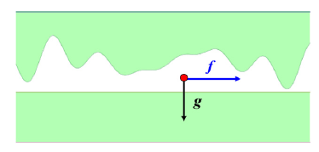
,
,
Tortuous channel
2d→1d

Slide 12
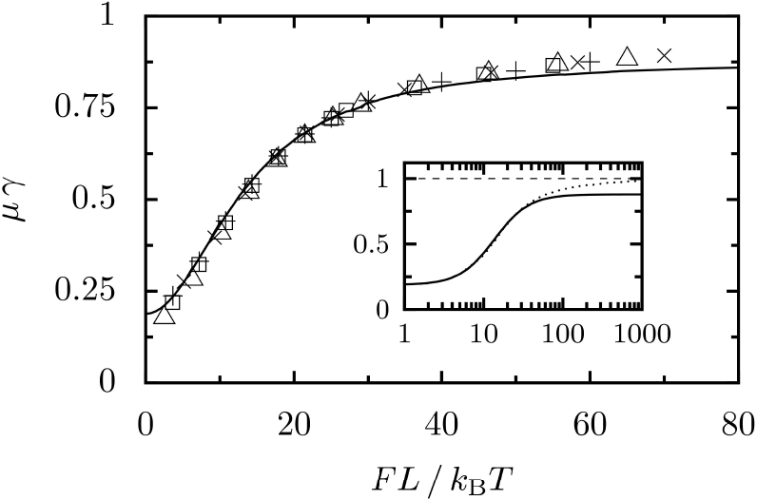
Scaling
FJ: solid lines
D. Reguera et al. PRL, 96, 130603 (2006)

Slide 13
Validity of the coarse-graining description
Time scales:
S. Burada et al. PRE (2008)
Equilibration in the transverse direction occurs when:

Slide 14
Local criterion:
Global criterion:
over the period L
Critical value:
(Minimum forcing beyond which
F-J is expected to fail)

Slide 16
relative error is less
than 1%
Below the limiting lines F-J is valid within the corresponding prescribed
relative error

Slide 17
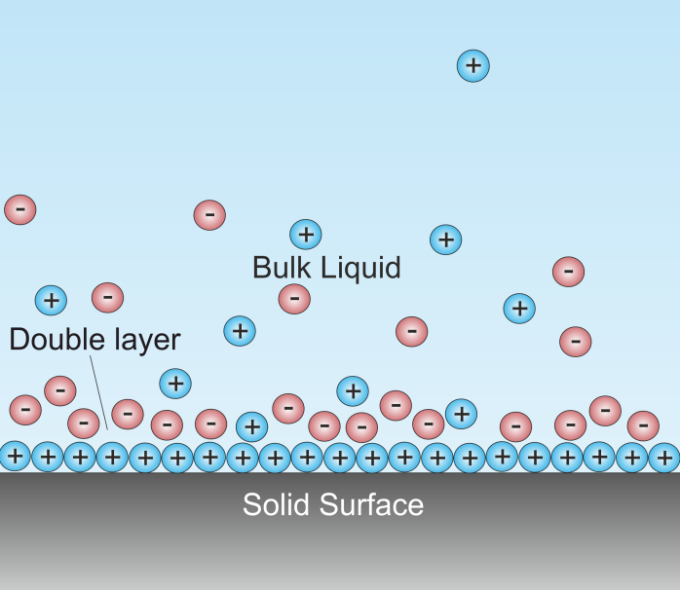
κh(x) ∼ 1 : New transport regimes
Entropic electrokinetics
An electrolyte embedded in a corrugated channel develops new transport regimes that can be exploited to i) separate suspended particles, ii) control electric and mass currents, iii) induce negative mobility.
E
bulk: neutral electrolyte
double layer

Slide 18
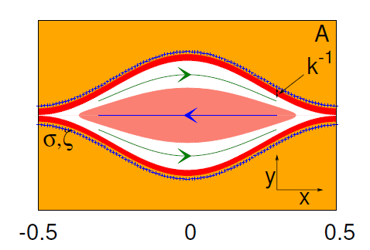
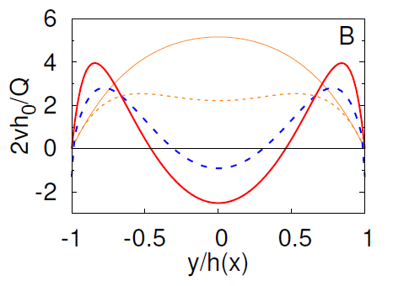
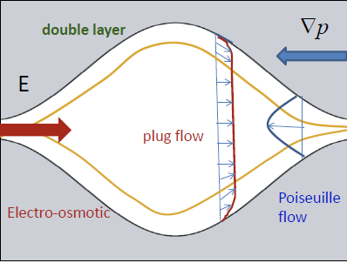
Recirculating region:
Velocity profiles for an electrolyte electro-osmotically driven inside
a varying-section insulating channel
x/L = 0, 0.25, 0.35, 0.4
P. Malgaretti, I. Pagonabarraga, J.M. Rubi, Phys. Rev. Lett., 113, 128301 (2014)

Slide 19
MFPT for charged tracers across corrugated channels
P. Malgaretti, I. Pagonabarraga, J.M. Rubi, J. Chem. Phys., 144, 034901 (2016)

Slide 20
Diffusion through flexible channels
-Channels are frequently modelled as isolated rigid structures not affected by the dynamics of the surrounding environment.
-However, as in vascular or peristaltic channels and in flexible DNA nano-channels these structures may become deformed under the action of a force.
-Channel deformations induced by time-dependent external forces can also be modelled by entropic barriers whose heights vary in time thus giving rise to time-dependent rectification and resonances when a periodic force is applied as well as to new scenarios for energy dissipation.

Slide 21
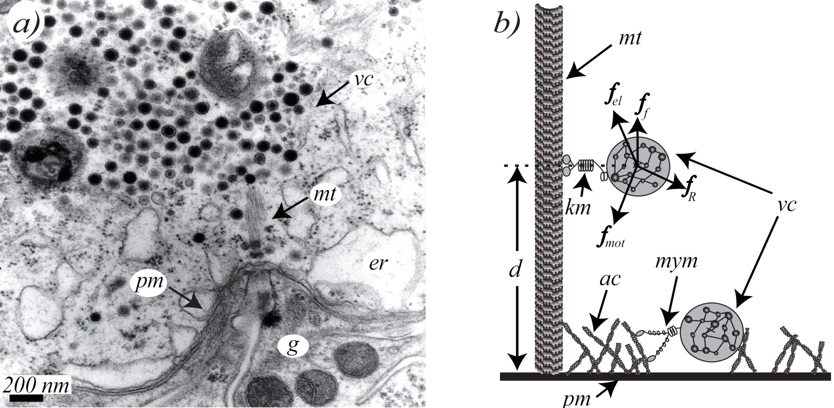
Entropic effects are ubiquitous at cellular level
Secretion of serotonin in neuronal soma
F.F. de Miguel et al., Plos One, 7, e45454 (2012)

Slide 22
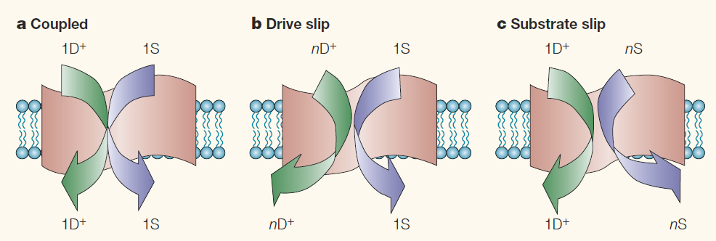
Flexible channels
Most transporters are flexible membrane proteins that can undergo many conformational changes.
Molecular slip: failure of ions in crossing the channel, observed in different molecular motors. Deviations from strict stoichiometry between ion movements and substrate transport.
This imperfection is necessary for the adaptation and smoothness of operation in many biological processes.
N. Nelson, A. Sacher, H. Nelson, Nature Reviews Molecular Cell Biology 3, 876 (2002)

Slide 23
Entropy-facilitated active transport
J. M. Rubi, A. Lervik, D. Bedeaux, and S. Kjelstrup, J. Phys. Chem., 146, 185101 (2017)

Slide 24
Model
L_1 tunes the asymmetry
M. F. Carusela, J.M. Rubi, J. Chem. Phys., 146, 184901 (2017); J. Phys.: Condens. Matter 30, 244001 (2018)

Slide 25
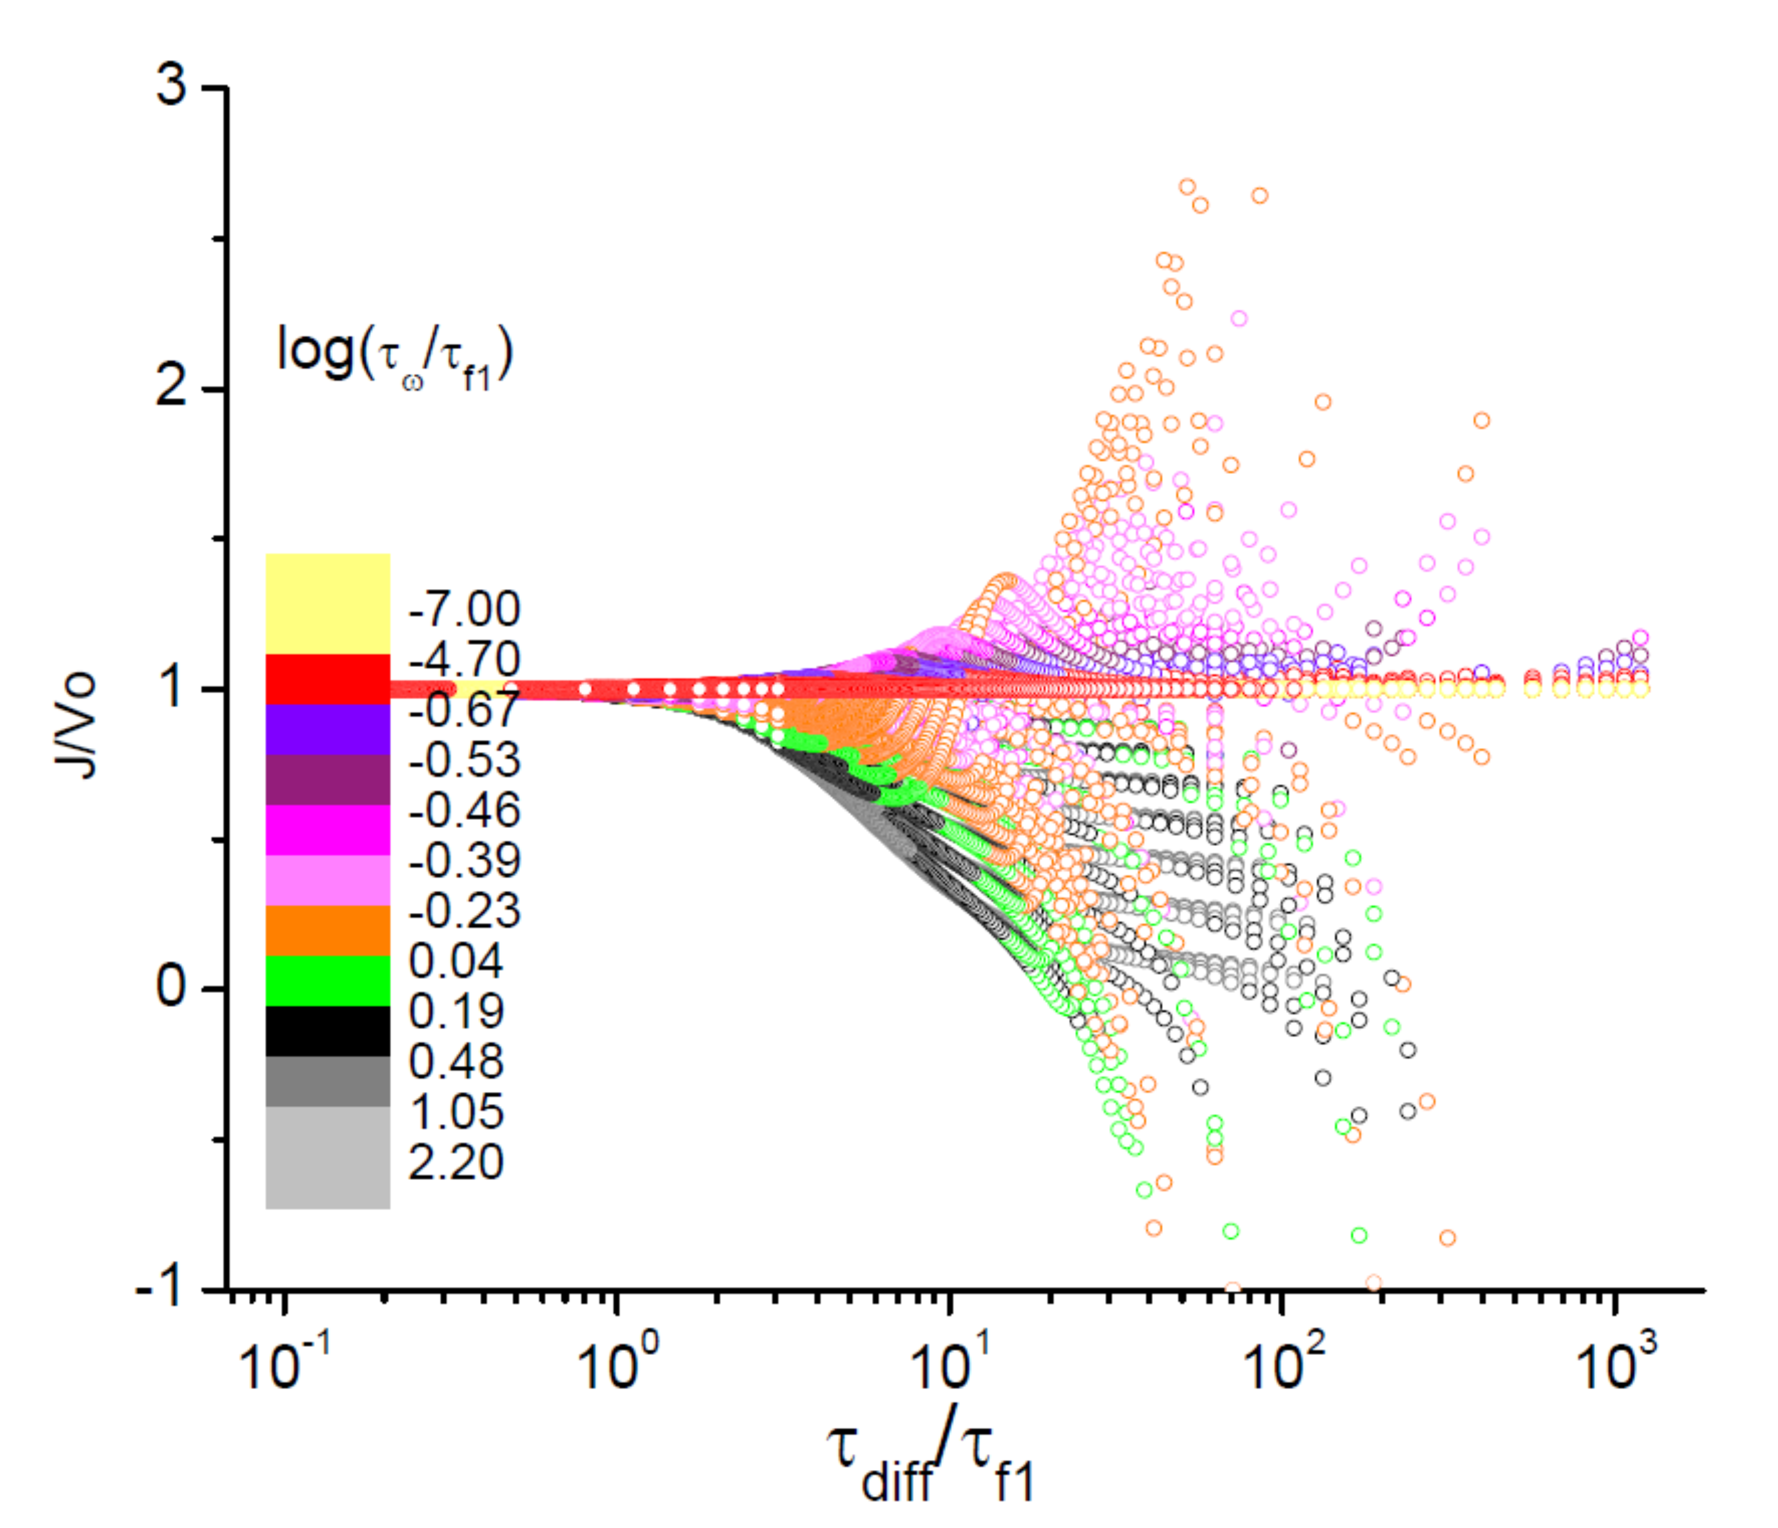

Slide 26
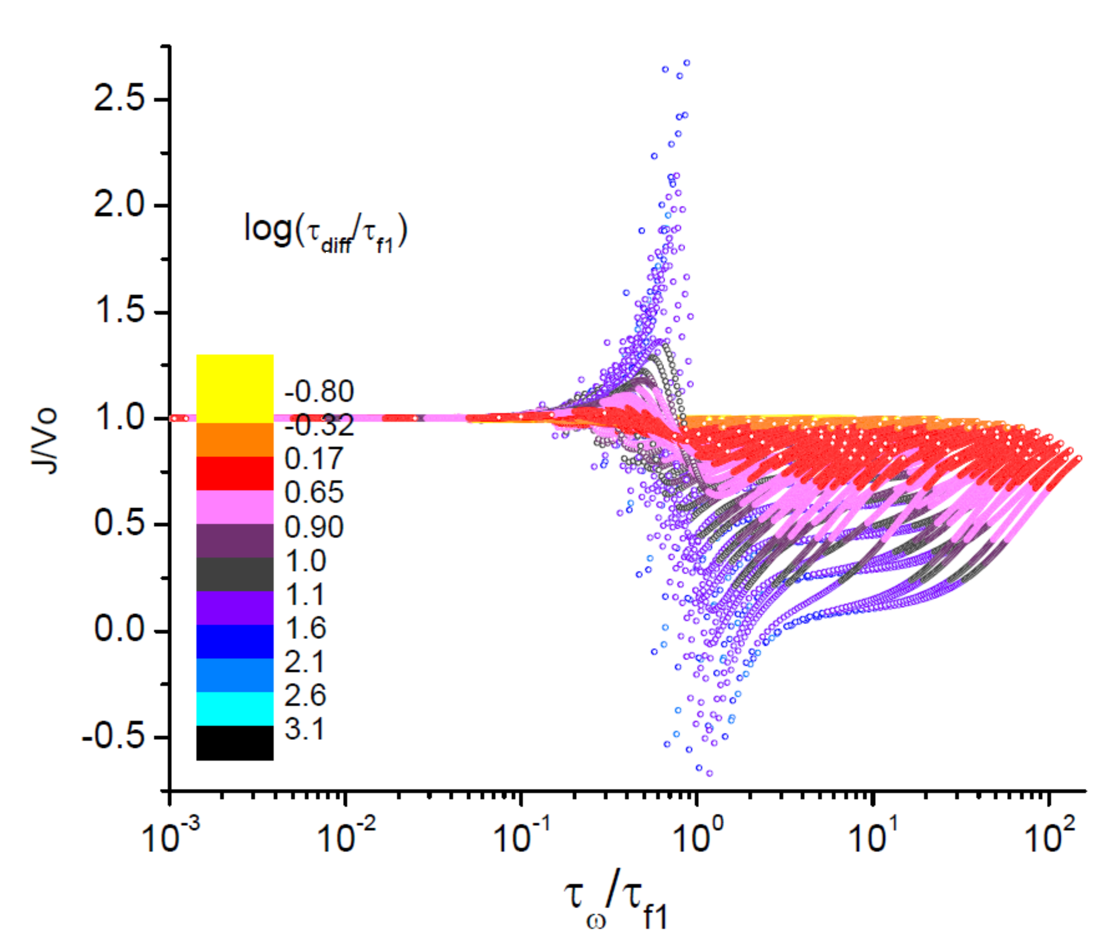

Slide 27
Energy dissipation
At high values of the applied force the entropy production is practically invariant under inversión of the force. At small values, when entropic effects become dominant, the symmetry is broken.

Slide 28
Stochastic resonance
Ornstein-Uhlenbeck:
J.M. Vilar, J.M. Rubi / Physica A, 264 (1999) 1
An excess of noise destroys the
coherence of the system
SNR has a maximum
SR

Slide 29
Conclusions
Importance of entropic effects in small-scale soft-matter and biological systems.
Entropic transport model is a useful tool to estimate entropic effects
The flexibility of the structures gives rise to new rectification scenarios with the appearance of resonances and backward movement of particles that can be used to optimize transport.

